Slide 1
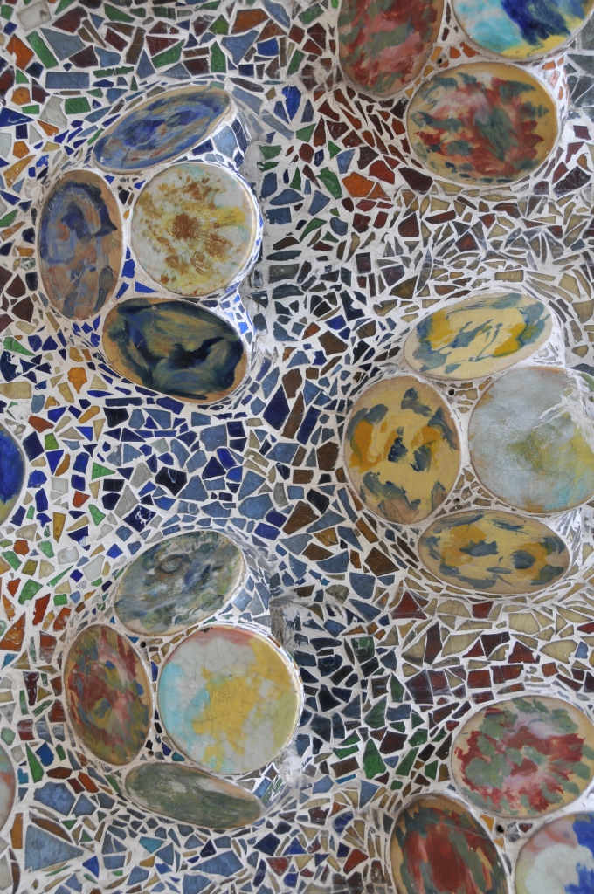
My Travel in ...
Barcelona
By Jacopo Favero

Slide 2
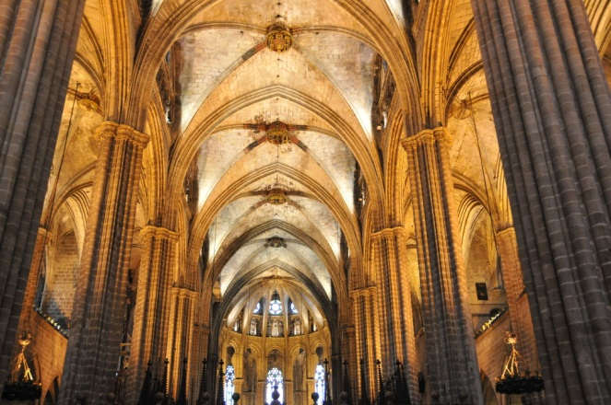
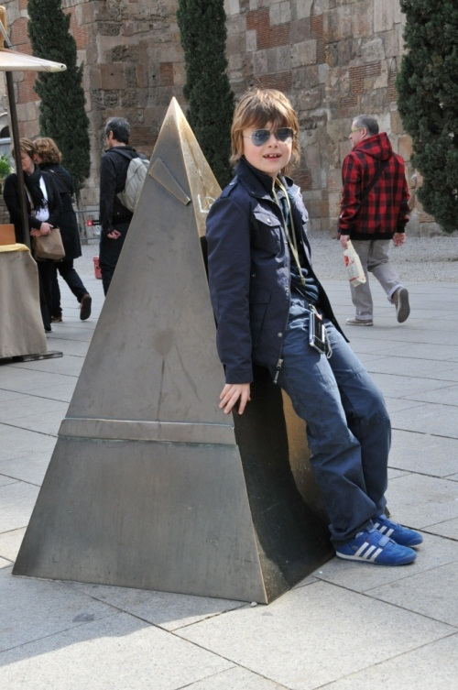
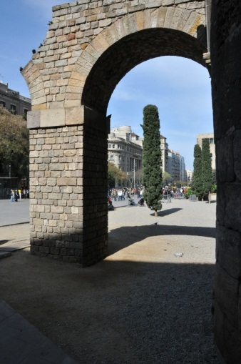
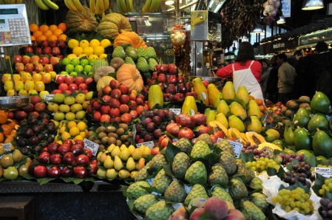
My Firsth Day
Finally I arrived in Barcelona.
Barcelona is a big city in Spain and it is on the sea.
This is my first day in Barcelona.
I was very excited because there are many monuments to visit.
Barcelona is a very ancient city. It has walls of Roman period. Inside these walls there is a very ancient part of the city called: “Bario gotic”.
In the Bario gotic there are many important monuments like the cathedral of the city.
The cathedral is one of the biggest in the world.
In the afternoon I went to the “Mercat de la Boqueria”. It is a covered market, where you can buy food or eat. It was very beautiful and colourful.
In the evening I went to eat “paella” at “el glop”. “Paella” is a typical Spanish dish, with rice, fish, chicken and vegetables.

Slide 3
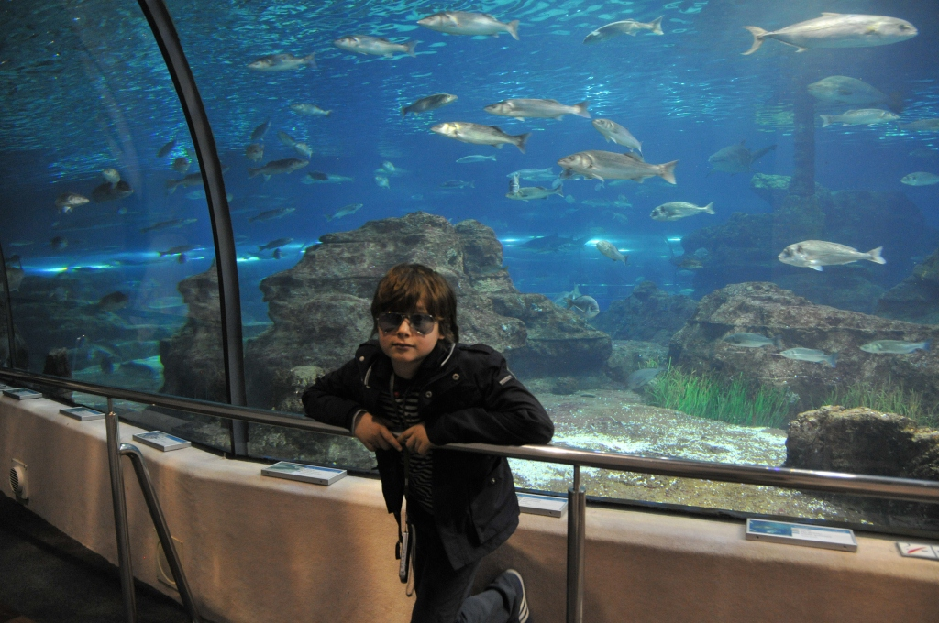
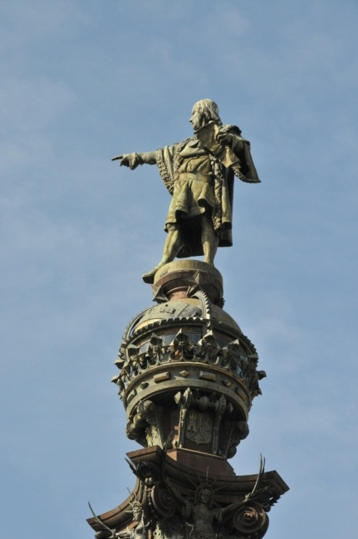
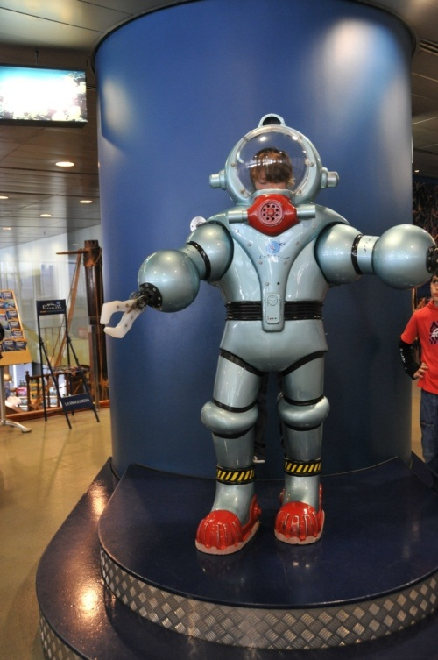
My Second Day
I love this city very much.
I went for a long walk on “la Rambla”: the most famous street in Barcelona. At the end of “la Rambla”, I saw the monument of Cristoforo Colombo.
Cristoforo Colombo was a very famous man that discovered America in 1492. His monument is in Barcelona because the King and the Queen of Spain paid his voyage.
Near Colombo’s monument, there is a district called “Barceloneta”. It was on the beach and it is famous because a long time ago it was the zone of the fishermen. Now it’s made up again, and now there is not more fishermen hovels.
After I saw the Aquarium and I saw many fishes: little fishes, big fishes, sharks, manta ray, penguins and fishes from all around the World. At the end of my visit, mum took me a photo into a diving suit.

Slide 4
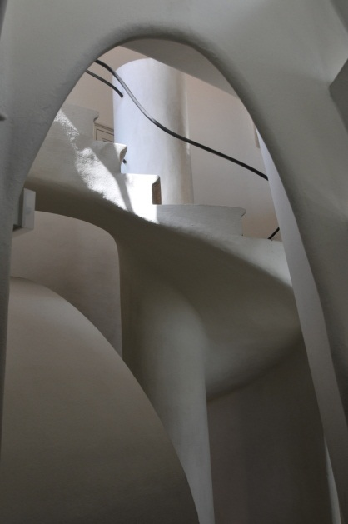
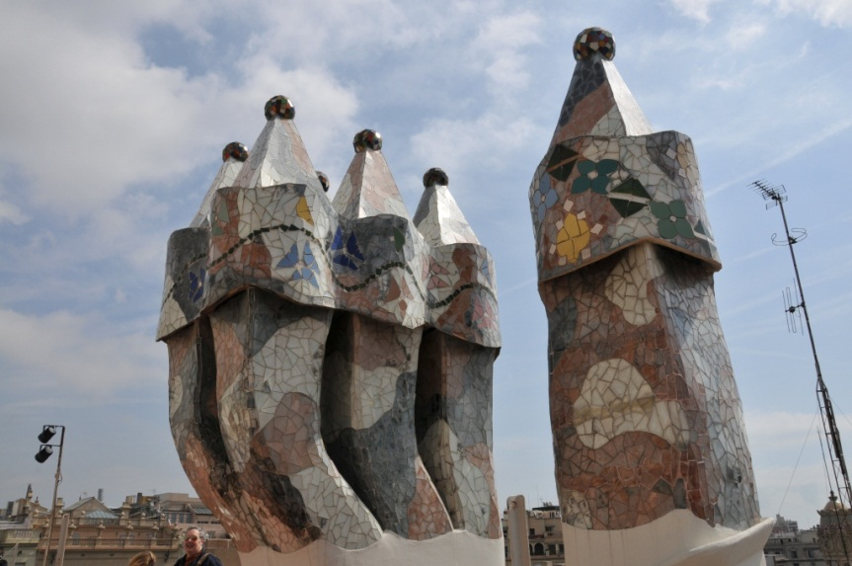
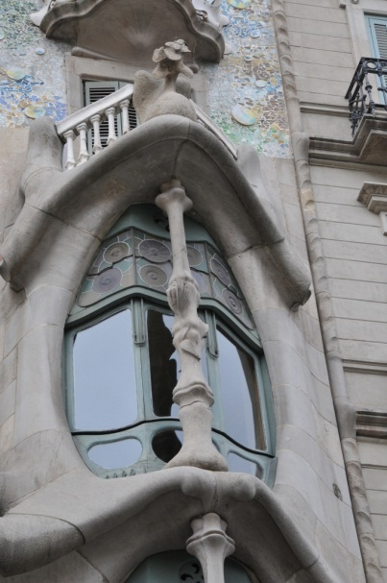
My Thirth Day
Today I am very tired.
I walked very much. This was the day dedicated to Anton Gaudì, a famous Spanish architect.
His projects were very imaginative.
First I saw “Casa Batllo”: a house without any right lines. All the walls And everything has curved lines.
For the particular form of its windows, it was called “the house of the bones” or “the house of yawns”.
I liked much the terrace and the roof with the colourful chimneypot.
Then I saw the “Sagrada Familia”. It is a big cathedral designed by Anton Gaudì but he was not able to see it finished, because he died under a tram. This particular cathedral was finished just last month. In the afternoon, I saw another work of Gaudì: “La Pedrera”.

Slide 5
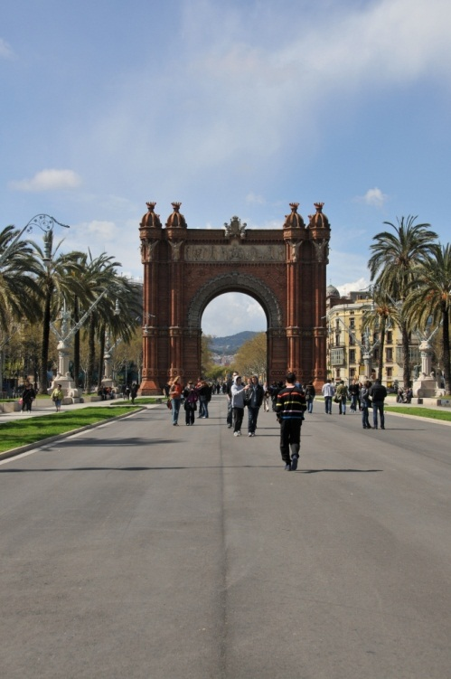
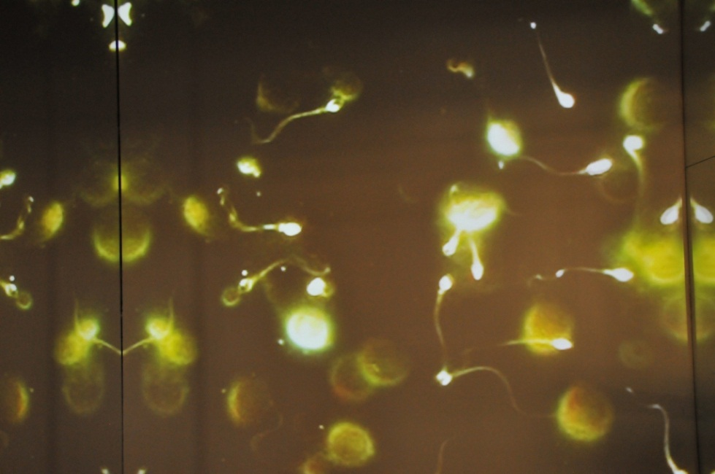
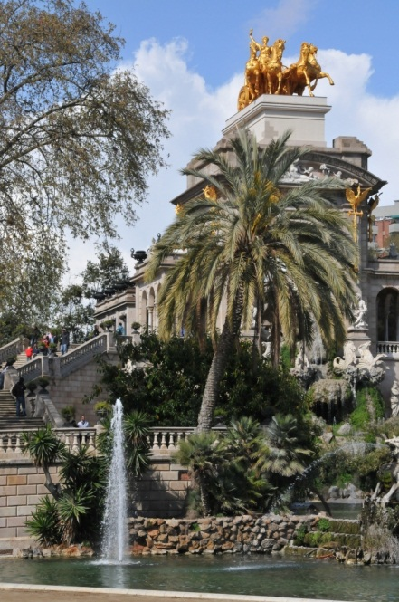
My Fourth Day
Today it is raining. How boring !
I spent my morning in the hotel doing my homework.
Finally there is the sun! I went to see an art exhibition with a lot of photos. It was wonderful!
After I went to eat “tapas”: they are very very good. They are similar to snacks, and are made with some bread and vegetables, cheese, potatoes, fish, meat.
After lunch I went to see the “Arco di trionfo” and the “Parco dela Ciudadela”. In the park there is an interesting museum about the animal’s evolution, the biodiversity and the story of Darwin.
Tomorrow it will be my last day in Barcelona: hope there will be the sun.

Slide 6
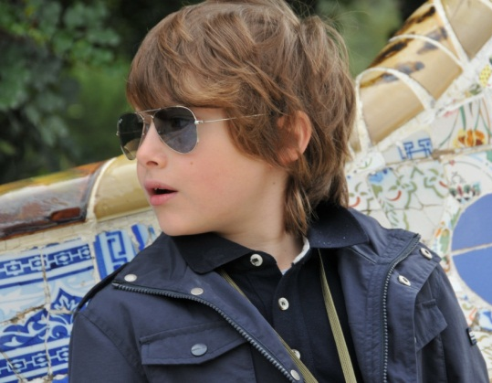
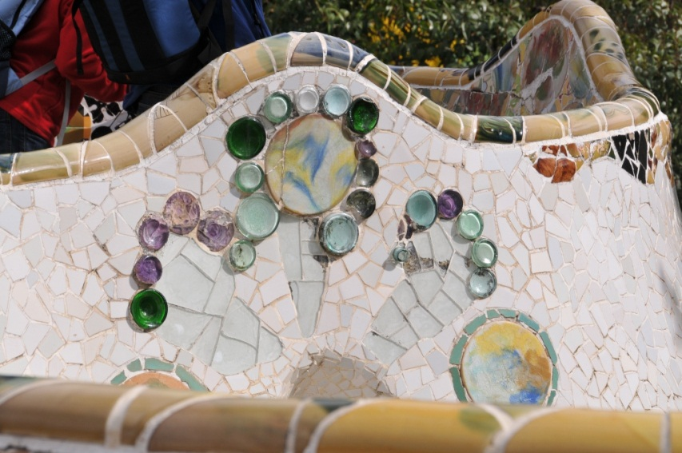
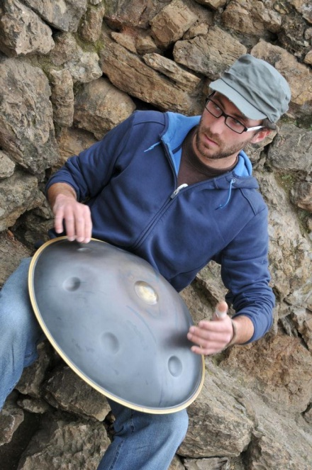
My Fifth Day (1)
And even today has gone …
Fortunately there was the sun!
I woke up very early in the morning to see the “Parco Guell”,
known as the Gaudì’s garden. They are on a little hill, and, like any construction of Gaudì, there are not right lines.
They are very colourful because every wall is covered with majolica and glass that reflected the light.
In the park there were people that played musical instruments: some of these are well-known, like guitar, some are strange like the “hang”.
The hang is similar to a wok, a Chinese pot, but it has a very relaxing sound.
My mum bought a CD of this instrument, so I can bring it to school.

Slide 7
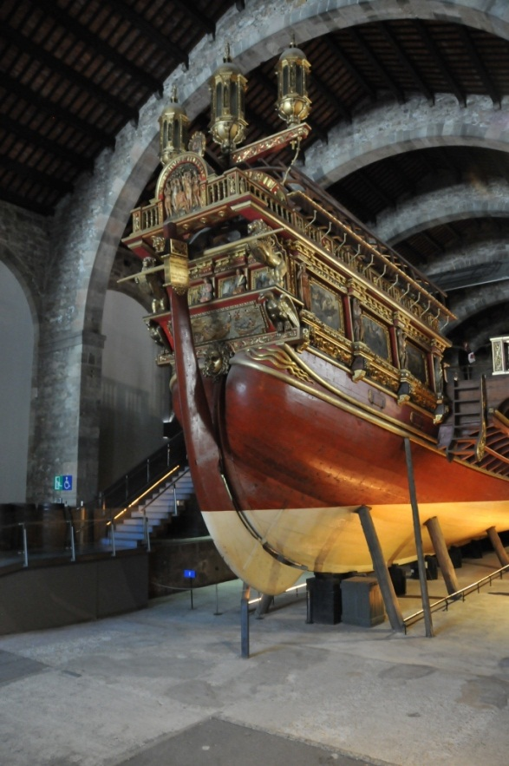
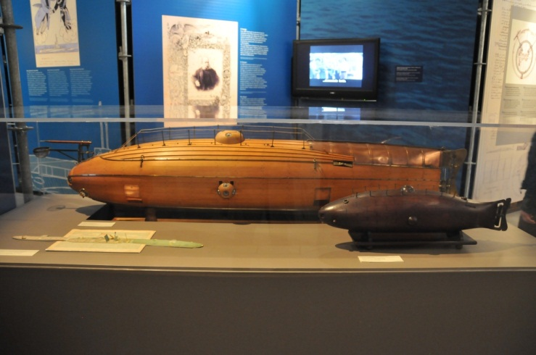
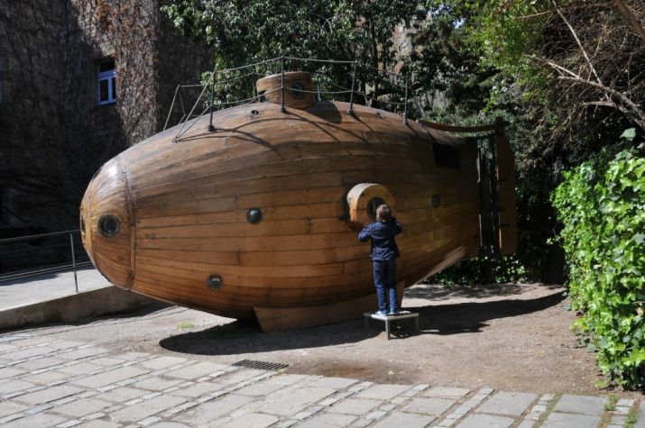
My Fifth Day (2)
… or not …
After seeing the “Parco Guell”, I went to the “Museo Maritim” where I saw many models of historic boats, and a real one.
There were even two models of ancient submariners made out of wood, and three real ones. They were coloured in Yellow………. Like the Beatles song!
Today I knew a taxi driver that told me that “Castellano language” is like “Veneto language”.
My holiday is finished. Tomorrow I will come back to my home, but I will remember Barcelona because it is a fantastic city!

